Slide 1

Natural Language Processing
Dong Xu
EECS Department
C. S. Bond Life Sciences Center
Informatics Institute
University of Missouri, Columbia
http://digbio.missouri.edu

Slide 2
Coverage
Introduction to NLP
NLP components and basic methods
Structure of RNN
Long Short-term Memory (LSTM)
Basic language models
BERT
NLP applications

Slide 3
什么是自然语言处理（NLP）
 自然语言≈人类语言
 区别于人工语言（比如程序语言）
自然语言处理包括语音识别、自然语言理解、自然 语言生成、人机交互以及所涉及的中间阶段。
 是人工智能和计算机科学的子学科。
基础技术 核心技术 应用
词法分析
句法分析
实体识别
语义分析
篇章分析
语言模型
机器翻译
自动问答
情感分析
信息抽取
文本摘要
文本蕴涵
智能客服
搜索引擎
个人助理
推荐系统
舆情分析
知识图谱

Slide 4
什么是自然语言处理（NLP）
 自然语言≈人类语言
 区别于人工语言（比如程序语言）
自然语言处理包括语音识别、自然语言理解、自然 语言生成、人机交互以及所涉及的中间阶段。
 是人工智能和计算机科学的子学科。
基础技术 核心技术 应用
词法分析
句法分析
实体识别
语义分析
篇章分析
语言模型
机器翻译
自动问答
情感分析
信息抽取
文本摘要
文本蕴涵
智能客服
搜索引擎
个人助理
推荐系统
舆情分析
知识图谱

Slide 5
自然语言处理的难点：歧义性
 以中文分词为例
 不同的语言环境中的同形异构现象，按照具体语言环境的
语义进行切法。
 交叉歧义
 他／说／的／确实／在理
 组合歧义
 两个/人/一起/过去、个人/问题
从马/上/下来、马上/就/来
 句子级歧义
 白天鹅在水里游泳
 该研究所获得的成果
伪歧义

Slide 6
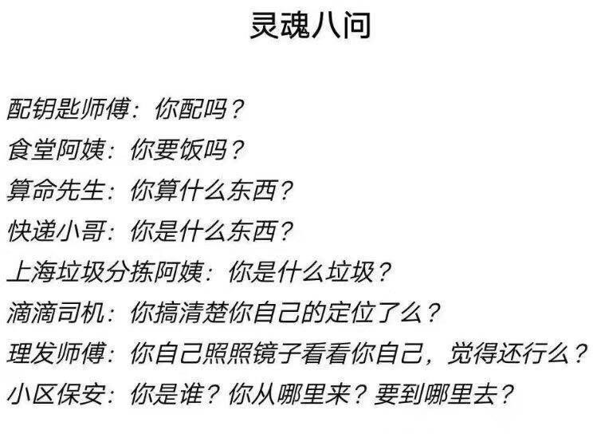
语义歧义

Slide 7
理想中的NLP技术路线
这是一棵语法树
分词
这 是 一 棵 语 法 树
词性标注
应用
语义分析 机器翻译 自动问答 情感分析 … …
这 是 一 棵 语法 树
代词 动词 数词 量词
名词 动词
句法分析
这, 是，语法树
语义分析
知识库
这 | 是 | 一 | 棵 | 语法 | 树
代词 | 动词 | 数词 | 量词 | 名词 | 动词

Slide 8
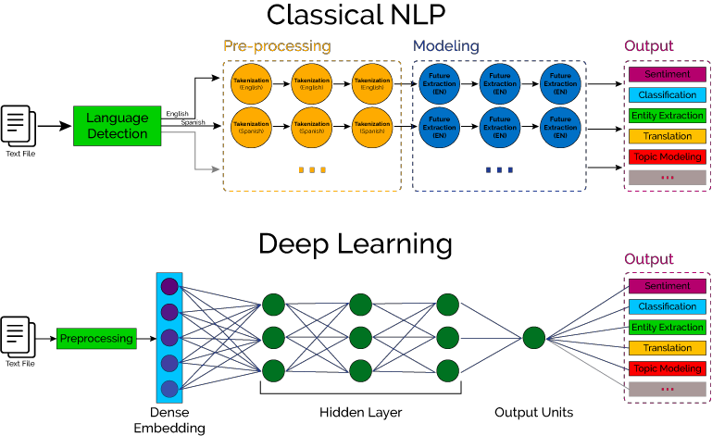
实际的NLP技术路线

Slide 9
自然语言处理中的典型任务
分类 序列标注 生成
机器翻译 文本摘要 风格迁移 自动问答 对话系统
文本分类
中文分词
情感分类
词性标注
文本匹配
文本蕴涵
信息抽取

Slide 10
中文处理任务

Slide 11







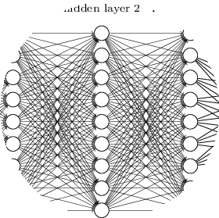



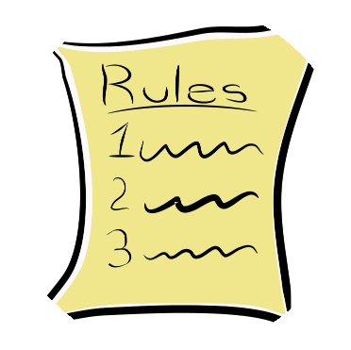


发展历程
数据驱动
2012年~
基于深度学习的方法
神经网络
分布式表示
非线性模型
规则驱动
1990年~2012年
基于统计学习的方法
离散表示
线性模型
1990年以前
基于规则的方法
交互
生成
理解

Slide 12
What is Natural Language Processing (NLP)
The process of computer analysis of input provided in a human language (natural language), and conversion of this input into a useful form of representation.
The field of NLP is primarily concerned with getting computers to perform useful and interesting tasks with human languages.
The field of NLP is secondarily concerned with helping us come to a better understanding of human language.
An ideal goal for human-computer communication is the ability to communicate in a natural language
NLP grew as a sub-domain of AI and linguistics
- the task of developing software capable of understanding information (commands, text) expressed in a natural language in order to achieve specific goals
Understanding natural languages is a challenging task for computers
Due to ambiguities, frequent use of context and the overall knowledge acquisition and use problem

Slide 13
Natural Language Processing Tasks
Natural Language Understanding
Taking some spoken/typed sentence and working out what it means
Natural Language Generation
Taking some formal representation of what you want to say and working out a way to express it in a natural (human) language (e.g., English)

Slide 14
Subdivisions of NLP
Parts of Speech and Morphology (words, their syntactic function in sentences, and the various forms they can take).
Phrase Structure and Syntax (regularities and constraints of word order and phrase structure).
Semantics (the study of the meaning of words (lexical semantics) and of how word meanings are combined into the meaning of sentences, etc.)
Pragmatics (the study of how knowledge about the world and language conventions interact with . literal meaning).

Slide 15
Brief History of NLP
1940s –1950s: Foundations
Development of formal language theory (Chomsky, Backus, Naur, Kleene)
Probabilities and information theory (Shannon)
1957 – 1970s:
Use of formal grammars as basis for natural language processing (Chomsky, Kaplan)
Use of logic and logic based programming (Minsky, Winograd, Colmerauer, Kay)
1970s – 1983:
Probabilistic methods for early speech recognition (Jelinek, Mercer)
Discourse modeling (Grosz, Sidner, Hobbs)
1983 – 1993:
Finite state models (morphology) (Kaplan, Kay)
1993 – present:
Strong integration of different techniques, different areas.

Slide 16
Ambiguity in Language
Almost in every level ambiguity is introduced, and one of the main tasks in NLP is to resolve such ambiguities.
I made her duck =
I cooked waterfowl for her.
I cooked waterfowl belonging to her.
I created the (plastic?) duck she owns.
I caused her to quickly lower her body.
I waved my magic wand and turned her into a waterfowl.
Time flies like an arrow vs. Fruit flies like a banana

Slide 17
Coverage
Introduction to NLP
NLP components and basic methods
Structure of RNN
Long Short-term Memory (LSTM)
Basic language models
BERT
NLP applications

Slide 18
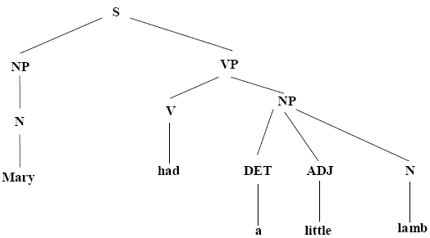
Lexicon
An internal dictionary used to perform the syntactic and semantic analysis
Contains semantic and grammatical information (e.g., part-of-speech) about words or word strings
Fig. An example parse tree for the sentence “Mary had a little lamb”

Slide 19
词表(Lexicon)
一个内部词典，用来进行句法和语义的分析
包含单词或此字符串的语义和语法信息 （举例：part-of-speech）
“Mary had a little lamb”的分析树

Slide 20
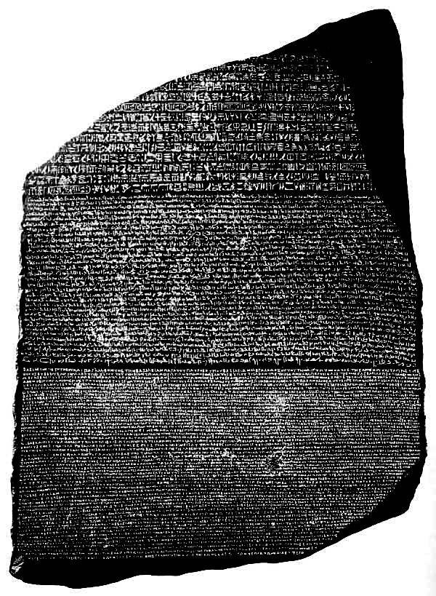
Corpora
A corpus is a collection of text
Often annotated in some way
Sometimes just lots of text
Balanced vs. uniform corpora
Newswire collections: 500M+ words
Example of “parallel text”: same text in two or more languages
Hieroglyphic Egyptian, Demotic Egyptian and classical Greek
Used to understand hieroglyphic writing system

Slide 21
语料库(Corpora)
一个语料库是一堆文本的集合
，一般都会被标注，一些情况下只是大量文本。
平衡语料库 vs. 统一语料库
新闻专集: 500M+ words
一个关于“平行文本”的例子：一些文本用两种或多种语言组成：​
罗塞塔石碑：古埃及象形文（圣书体）, 埃及草书（世俗体），古希腊文​
平行文本可以用来理解象形文字书写系统

Slide 22
semantic analyser and the knowledge base
The semantic analyser uses the parse tree and the knowledge base to try to determine what the sentence means
It creates another data structure that represents the meaning of the input sentences
It can also draw inferences from input statements using general knowledge in the KB
The semantic analyser's data structure and those in the KB should be in a common knowledge representation, such as KQML or Conceptual Graphs

Slide 23
Knowledge of Language
What does it mean to know a language?
Know the words (lexicon)
Pronunciation, Formation, Conjugation
Know how the words form sentences
Sentence structure, Compositional meaning
Know how to interpret the sentence
Statement, question,..
Know how to group sentences
Narrative coherence, dialogue

Slide 24
语言学基础知识
会一门语言意味着什么?
掌握单词（词表lexicon）
发音，格式，动词的变化
知道单词是如何组成句子的
句式结构，各成分的意义
知道怎么解释句子的意义
陈述，疑问…
知道怎么将句子分组
叙事连贯，对话

Slide 25
Knowledge of Language
Phonology – concerns how words are related to the sounds that realize them.
Morphology – concerns how words are constructed from more basic meaning units called morphemes. A morpheme is the primitive unit of meaning in a language.
Syntax – concerns how can be put together to form correct sentences and determines what structural role each word plays in the sentence and what phrases are subparts of other phrases.
Semantics – concerns what words mean and how these meaning combine in sentences to form sentence meaning. The study of context-independent meaning.

Slide 26
Knowledge of Language
Pragmatics – concerns how sentences are used in different situations and how use affects the interpretation of the sentence.
Discourse – concerns how the immediately preceding sentences affect the interpretation of the next sentence. For example, interpreting pronouns and interpreting the temporal aspects of the information.
World Knowledge – includes general knowledge about the world. What each language user must know about the other’s beliefs and goals.

Slide 27
语言学基础知识
音系学 （Phonology） – 关注单词与声音之间的关系以及意识到这些关系。
形态学（Morphology） – 关注如何从中构造单词，更基本的意义单位称为语素。 语素是语言中意义的原始单位。
句法（Syntax） – 关注如何将单词放在一起以形成正确的句子并确定每个单词在句子里的结构作用以及哪些短语是其他句子的子部分.
语义（Semantics） – 关注单词的含义以及这些含义如何在句子中组合以形成句子含义。对上下文无关意义的研究。

Slide 28
语言学基础知识
语用（Pragmatics） – 在不同情况下如何使用句子以及使用如何影响句子的解释。
语篇 （Discourse） – 涉及紧接在前的句子如何影响下一个句子的解释。 例如，解释代词和解释信息的时间方面。
知识图谱（Knowledge graph） – 包含关于世界的一般知识。

Slide 29
Why NL Understanding is hard?
Natural language is extremely rich in form and structure, and very ambiguous.
How to represent meaning,
Which structures map to which meaning structures.
One input can mean many different things. Ambiguity can be at different levels.
Lexical (word level) ambiguity -- different meanings of words
Syntactic ambiguity -- different ways to parse the sentence
Interpreting partial information -- how to interpret pronouns
Contextual information -- context of the sentence may affect the meaning of that sentence.
Many input can mean the same thing.
Interaction among components of the input is not clear.

Slide 30
Natural language understanding
Raw speech signal
Speech recognition
Sequence of words spoken
Syntactic analysis using knowledge of the grammar
Structure of the sentence
Semantic analysis using info. about meaning of words
Partial representation of meaning of sentence
Pragmatic analysis using info. about context
Final representation of meaning of sentence

Slide 31
句法分析
句法（语法）规则规定了句子中单词可以组合的方式，并允许我们确定句子的结构
“John saw Mary with a telescope”
John saw (Mary with a telescope)
John (saw Mary with a telescope)
以与我们对世界认知一致的方式将单词和结构映射到特定的领域对象。
解析：给出一个句子和一个语法
根据语法检查句子是否正确，如果是，则返回表示句子结构的分析树

Slide 32
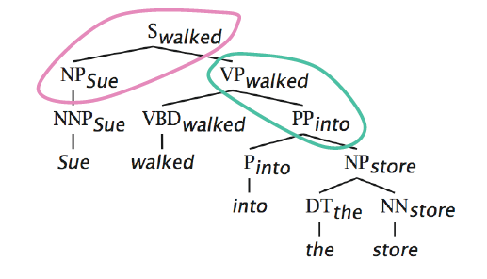
分析树
句法分析

Slide 33
Semantic Analysis
Assigning meanings to the structures created by syntactic analysis.
Mapping words and structures to particular domain objects in way consistent with our knowledge of the world.
Semantic can play an import role in selecting among competing syntactic analyses and discarding illogical analyses.
We have to decide the formalisms which will be used in the meaning representation.

Slide 34
Parsing & semantic analysis
Rules: syntactic rules or semantic rules
What component can be combined with what component?
What is the result of the combination?
Categories
Syntactic categories: Verb, Noun, …
Semantic categories: Person, Fruit, Apple, …
Analyses
Recognize the category of an element
See how different elements can be combined into a sentence
Problem: The choice is often not unique

Slide 35
解析(parsing)与语义分析 (semantic analysis)
规则：句法规则或语义规则
哪部分可以与哪部分结合？
组合出的是什么？
类别
句法类别：动词，名词， …
语义类别：人，水果，苹果, …
分析
识别出一个元素的类别
知道如何将不同的元素组合成一个句子
一个问题：选项通常不唯一

Slide 36
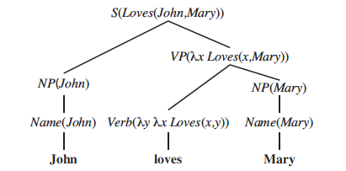
Semantic analysis grammar
S(pred(obj)) -> NP(obj) VP(pred)
VP(pred(obj)) -> Verb(pred) NP(obj)
NP(obj) -> Name(obj)
Name(John) -> John
Name(Mary) -> Mary
Verb(λyλx Loves(x,y)) -> loves

Slide 37
语义分析语法
S(pred(obj)) -> NP(obj) VP(pred)
VP(pred(obj)) -> Verb(pred) NP(obj)
NP(obj) -> Name(obj)
Name(John) -> John
Name(Mary) -> Mary
Verb(λyλx Loves(x,y)) -> loves

Slide 38
RULE 15:
S(x0:NP, x1:VP, x2:PUNC)
→ x0 , x1 , x2
“These 7 people include astronauts coming from France and Russia”
RULE 14:
VP(x0:VBP, x1:NP)
→ x0 , x1
“include astronauts coming from
France and Russia”
“astronauts coming from
France and Russia”
RULE 16:
NP(x0:NP, x1:VP)
→ x1 , 的 , x0
“coming from France and Russia”
RULE 11:
VP(VBG(coming), PP(IN(from), x0:NP))
→ 来自 , x0
“these 7 people”
“France and Russia”
RULE 10:
NP(x0:DT, CD(7), NNS(people)
→ x0 , 7人
RULE 13:
NP(x0:NNP, x1:CC, x2:NNP)
→ x0 , x1 , x2
“these”
“include”
“France”
“&”
“Russia”
“astronauts”
“.”
RULE 1:
DT(these)
→ 这
RULE 2:
VBP(include)
→ 中包括
RULE 4:
NNP(France)
→ 法国
RULE 5:
CC(and)
→ 和
RULE 6:
NNP(Russia)
→ 俄罗斯
RULE 8:
NP(NNS(astronauts))
→ 宇航 , 员
RULE 9:
PUNC(.)
→ .
这 7人 中包括 来自 法国 和 俄罗斯 的 宇航 员 .
推导树

Slide 39
Pragmatics
Practical usage of language: what a sentence means in practice (intentions)
Do you have time?
How do you do?
Uses context of utterance
Where, by who, to whom, why, when it was said
Intentions: inform, request, promise, criticize, …
Handling Pronouns
“Mary eats apples. She likes them.”
She=“Mary”, them=“apples”.
Handling ambiguity
Pragmatic ambiguity: “you’re late”: What’s the speaker’s intention: informing or criticizing?

Slide 40
语用学 （Pragmatics）
语言的实际使用：句子在实践中的含义（意图）
你有空吗？
你好吗？
使用上下文
何时，何人，向谁，为什么，何时说
意图：告知，要求，承诺，批评, …
处理代词
“Mary eats apples. She likes them.”
She=“Mary”, them=“apples”.
处理歧义
现实中的歧义：“你晚了”，这是批评还是告知？

Slide 41
Discourse
Discourses are collection of coherent sentences (not arbitrary set of sentences)
Discourses have also hierarchical structures (similar to sentences)
anaphora resolution -- to resolve referring expression
Mary bought a book for Kelly. She didn’t like it.
She refers to Mary or Kelly. -- possibly Kelly
It refers to what -- book.
Mary had to lie for Kelly. She didn’t like it.
Discourse structure may depend on application.
Monologue
Dialogue
Human-Computer Interaction

Slide 42
语篇 （Discourse）
语篇是连贯语句（不是任意语句集）的集合
语篇也具有层次结构（类似于语句）
复指分辨率 anaphora resolution -- 解决引用表达式
Mary bought a book for Kelly. She didn’t like it.
She 指 Mary 或 Kelly. – 可能是 Kelly
It 指 book.
Mary had to lie for Kelly. She didn’t like it.
语篇结构可能会根据应用改变
独白
对话
人机交互

Slide 43
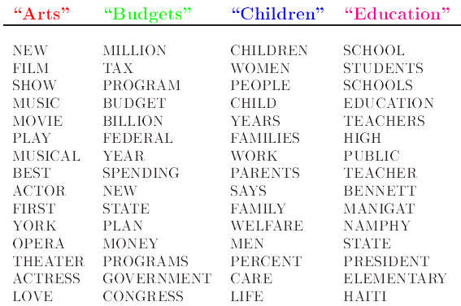
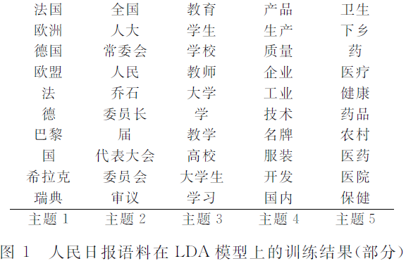
主题模型

Slide 44
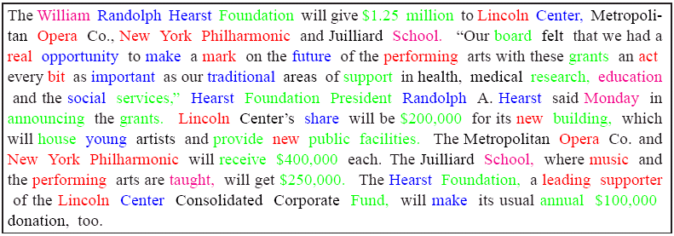
主题模型

Slide 45
LDA模型（Latent Dirichlet Allocation）
Document specific distribution over topics
Documents
Topic distribution over words
Topic
Word
◆ David M. Blei, Andrew Y. Ng and Michael I. Jordan, 2003. Latent Dirichlet Allocation. Journal of Machine Learning Research, Vol. 3, No. Jan, pp. 993-1022.

Slide 46
LDA
(Latent Dirichlet Allocation)

Slide 47

LDA Example
http://www.yyyweb.com/demo/inner-show/word-itout.html

Slide 48
Word-level Knowledge
Lexicon:
List of legal words in a language
Part of speech:
noun, verb, adjective, determiner
Example:
Noun -> cat | dog | mouse | ball | rock
Verb -> chase | bite | fetch | bat
Adjective -> black | brown | furry | striped | heavy
Determiner -> the | that | a | an

Slide 49
Sentence-level Knowledge: Syntax
Language models
More than just words: “banana a flies time like”
Formal vs natural: Grammar defines language
Recursively
Enumerable
=Any
Chomsky
Hierarchy
Context = AB->BA
Sensitive
Context A-> aBc
Free
Regular S->aS
Expression a*b*

Slide 50
Pragmatics & Discourse
Interpretation in context
Act accomplished by utterance
“Do you have the time?”, “Can you pass the salt?”
Requests with non-literal meaning
Also, includes politeness, performatives, etc
Interpretation of multiple utterances
“The cat chased the mouse. It got away.”
Resolve referring expressions

Slide 51
Aspects of language processing
Word, lexicon: lexical analysis
Morphology, word segmentation
Syntax
Sentence structure, phrase, grammar, …
Semantics
Meaning
Execute commands
Discourse analysis
Meaning of a text
Relationship between sentences (e.g. anaphora)

Slide 52
Morphological analysis
Goal: recognize the word and category
Using a dictionary: word + category
Input form (computed)
Morphological rules:
Lemma + ed -> Lemma + e (verb in past form)
…
Is Lemma in dict.? If yes, the transformation is possible
Form -> a set of possible lemmas

Slide 53
Natural Language Toolkit (NLTK)
NLTK is a suite of open source Python modules, data sets and tutorials
Supporting research and development in natural language processing
Download NLTK from nltk.org
all code, data, documentation is free

Slide 54
Natural Language Toolkit (NLTK)
NLTK是一套开源Python模块，数据集和教程
用来支持自然语言处理的研究与开发
从nltk.org下载NLTK
所有代码，数据，文档完全免费

Slide 55
Components of NLTK
Code: corpus readers, tokenizers, stemmers, taggers, chunkers, parsers, wordnet, ... (50k lines of code)
Corpora: >30 annotated data sets widely used in natural language processing (>300Mb data)
Documentation: a 400-page book, articles, reviews, API documentation

Slide 56
NLTK内容
代码: corpus readers（语料库阅读），tokenizer（ 标记解析 ），stemmers（词干生成），taggers（标记），chukers（分块），parsers（解析器），wordnet，... 共有五万多行代码
语料库: 超过30个标注数据集，被广泛应用在自然语言处理领域（超过300Mb数据）
文档: 超过400页的资料，包含文章，评价，和API文档

Slide 57
代码内容
corpus readers 语料库阅读
tokenizers 标记解析
stemmers 词干生成
taggers 标注
parsers 语法分析
wordnet 词关系词典
semantic interpretation 语义解释
clustering 聚类
evaluation metrics 评估指标
…

Slide 58
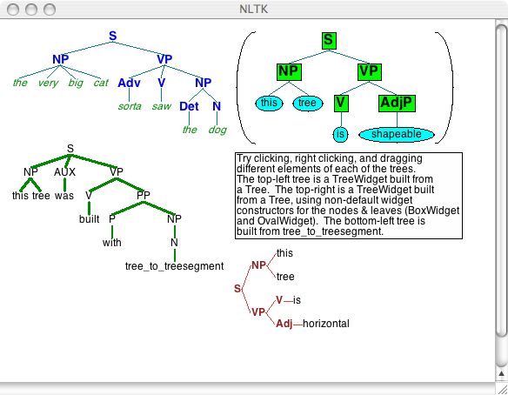

Slide 59
Coverage
Introduction to NLP
NLP components and basic methods
Structure of RNN
Long Short-term Memory (LSTM)
Basic language models
BERT
NLP applications

Slide 60
Limitations of DNN/CNN
The applications of standard Neural Networks (and also Convolutional Networks) are limited due to:
They only accepted a fixed-size vector as input (e.g., an image) and produce a fixed-size vector as output (e.g., probabilities of different classes).
These models use a fixed amount of computational steps (e.g. the number of layers in the model).
No memory in the network.

Slide 61
DNN/CNN的局限
标准的神经网络（以及CNN）应用受限于：
它们只接受固定大小的向量作为输入（例如图像），并产生固定大小的向量作为输出（例如不同类别的概率）。
这些模型使用固定数量的计算步骤（例如，模型中的层数）。
网络中没有存储记忆。

Slide 62
Neural Network needs Memory
Name Entity Recognition
Detecting named entities like name of people, locations, organization, etc. in a sentence.
1
DNN
0.1
people
apple
0
…
0.1
location
0
0.5
organization
0.3
none
0

Slide 63
需要存储记录的神经网络
名称实体识别
在句子中检查名称实体例如人名，地点，组织等
1
DNN
0.1
人名
苹果
0
…
0.1
地点
0
组织
0.5
0.3
无
0

Slide 64
Neural Network needs Memory
Name Entity Recognition
Detecting named entities like name of people, locations, organization, etc. in a sentence.
target
ORG
target
NONE
y¹
y²
y³
y⁴
y⁵
y⁶
y⁷
DNN
DNN
DNN
DNN
DNN
DNN
DNN
x¹
x²
x³
x⁴
x⁵
x⁶
x⁷
the president of apple eats an apple
Notes:
DNN: input and output are both vector

Slide 65
需要存储记录的神经网络
名称实体识别
在句子中检查名称实体例如人名，地点，组织等。
target
ORG
target
NONE
y¹
y²
y³
y⁴
y⁵
y⁶
y⁷
DNN
DNN
DNN
DNN
DNN
DNN
DNN
x¹
x²
x³
x⁴
x⁵
x⁶
x⁷
the president of apple eats an apple
Notes:
DNN: input and output are both vector

Slide 66
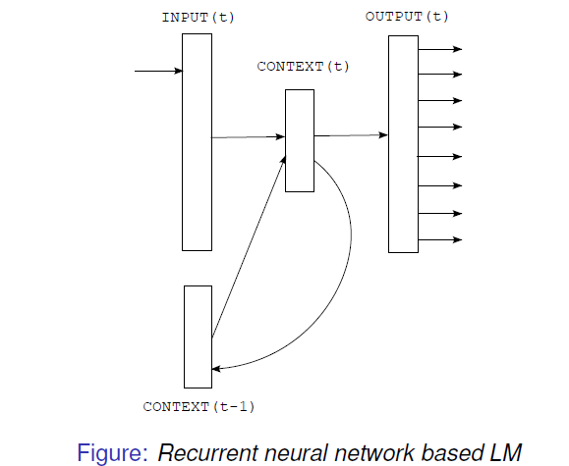
Recurrent Neural Network (RNN)
1. At the time t, the input is formed by concatenating vector w and output from context layer at previous time.
2. The output is the probability of the next word

Slide 67
循环神经网络（RNN）
1. 在时间节点t，输入由向量w和前一个时间节点context层的输出连接形成
2. 输出为下一个单词的概率

Slide 68

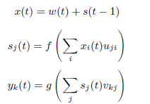
RNN Structure
At time t, the calculation is based on all the information collected till time t-1.
Each time, one word. Each epoch, one iteration.
Shared weights

Slide 69
RNN 的结构
在时间t处的计算基于在t之前收集的所有信息.
每个时间给一个单词，每个epoch算作一次迭代。
共享权重

Slide 70
RNN Implementation
y¹
y²
y³
Wº
copy
Wº
copy
Wº
a¹
a²
a³
a¹
a²
W^{h}
W^{h}
W^{i}
W^{i}
W^{i}
x¹
x²
x³
The same network is used again and again.
Output y^{i} depends on x¹, x², …… x^{i}
Notes:
General idea

Slide 71
RNN 的实现
y¹
y²
y³
Wº
copy
Wº
copy
Wº
a¹
a²
a³
a¹
a²
W^{h}
W^{h}
W^{i}
W^{i}
W^{i}
x¹
x²
x³
同样的网络结构重复使用.
输出 y^{i} 基于 x¹, x², …… x^{i}
Notes:
General idea

Slide 72
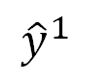
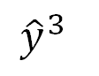
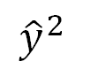
RNN
How to train?
$${\hat{y}}^{1}$$
target
$${\hat{y}}^{2}$$
target
$${\hat{y}}^{3}$$
target
L¹
L²
L³
y¹
y²
y³
Wº
Wº
Wº
W^{h}
W^{h}
……
W^{i}
W^{i}
W^{i}
x¹
x²
x³
Find the network parameters to minimize the total cost:
Backpropagation through time (BPTT)
Notes:
General idea

Slide 73
RNN
如何训练
$${\hat{y}}^{1}$$
target
$${\hat{y}}^{2}$$
target
$${\hat{y}}^{3}$$
target
L¹
L²
L³
y¹
y²
y³
Wº
Wº
Wº
W^{h}
W^{h}
……
W^{i}
W^{i}
W^{i}
x¹
x²
x³
找到网络参数来最小化总花销 :
Backpropagation through time (BPTT)
Notes:
General idea

Slide 74
Of course it can be deep …
y^{t}
y^{t+1}
y^{t+2}
……
……
……
……
……
……
……
……
……
x^{t}
x^{t+1}
x^{t+2}

Slide 75
可以继续加深层数…
y^{t}
y^{t+1}
y^{t+2}
……
……
……
……
……
……
……
……
……
x^{t}
x^{t+1}
x^{t+2}

Slide 76
RNN Applications
RNNs are unique as they allow us to operate over sequences of vectors.
Sequences in the input, the output, or in the most general case both
We need to model the data with temporal or sequential structures and varying length of inputs and outputs
Frames from video
Snippets of audio
Words pulled from sentences

Slide 77
RNN 应用
RNN特殊在它们使我们可以操作向量序列.
一般情况下，输入和输出向量都是序列
我们需要对数据建模，使用时间或顺序的模型结构，可变长度的输入和输出
视频逐帧
音频逐段
语句逐词

Slide 78
举例：写一个少儿读物
Doug saw Jane.
Jane saw Spot.
Spot saw Doug.
...
Your dictionary is small: {Doug, Jane, Spot, saw, …}

Slide 83
RNN可能会犯的错误
Doug saw Doug.
Jane saw Spot saw Doug saw …
Spot. Doug. Jane.

Slide 84
Coverage
Introduction to NLP
NLP components and basic methods
Structure of RNN
Long Short-term Memory (LSTM)
Basic language models
BERT
NLP applications

Slide 85
LSTM – Long Short Term Memory
Hochreiter & Schmidhuber (1997) solved the problem of getting an RNN to remember things for a long time (like hundreds of time steps).
Sepp Hochreiter
Jürgen Schmidhuber
Notes:
Could combine G and I weights, but more power this way
In the recurrency of the LSTM the activation function is the identity function with a derivative of 1.0. So, the backpropagated gradient neither vanishes or explodes when passing through, but remains constant.
The effective weight of the recurrency is equal to the forget gate activation. So, if the forget gate is on (activation close to 1.0), then the gradient does not vanish. Since the forget gate activation is never>1.0>1.0, the gradient can't explode either.
Use Maliya slides to show gradients. Need delta c to calculate c-1, since all weight deltas are just products with c, then c keeps control of vanishing/exploding gradients for most part

Slide 86
LSTM (Long Short Term Memory)长短期记忆模型
Hochreiter & Schmidhuber(1997) 解决了使用RNN记忆过去状态的问题，使得RNN能记忆大约100步时间状态
Sepp Hochreiter
Jürgen Schmidhuber
Notes:
Could combine G and I weights, but more power this way
In the recurrency of the LSTM the activation function is the identity function with a derivative of 1.0. So, the backpropagated gradient neither vanishes or explodes when passing through, but remains constant.
The effective weight of the recurrency is equal to the forget gate activation. So, if the forget gate is on (activation close to 1.0), then the gradient does not vanish. Since the forget gate activation is never>1.0>1.0, the gradient can't explode either.
Use Maliya slides to show gradients. Need delta c to calculate c-1, since all weight deltas are just products with c, then c keeps control of vanishing/exploding gradients for most part

Slide 87
LSTM – Long Short Term Memory
Hochreiter & Schmidhuber designed a memory cell using logistic and linear units with multiplicative interactions.
Information gets into the cell whenever its “write” gate is on.
The information stays in the cell so long as its “keep” gate is on.
Information can be read from the cell by turning on its “read” gate.
Notes:
Could combine G and I weights, but more power this way
In the recurrency of the LSTM the activation function is the identity function with a derivative of 1.0. So, the backpropagated gradient neither vanishes or explodes when passing through, but remains constant.
The effective weight of the recurrency is equal to the forget gate activation. So, if the forget gate is on (activation close to 1.0), then the gradient does not vanish. Since the forget gate activation is never>1.0>1.0, the gradient can't explode either.
Use Maliya slides to show gradients. Need delta c to calculate c-1, since all weight deltas are just products with c, then c keeps control of vanishing/exploding gradients for most part

Slide 88
LSTM – Long Short Term Memory
Hochreiter & Schmidhuber 使用逻辑和线性单元结合Multiplicative Interaction设计了一个记忆单元。
当“write”门打开的时候，信息进入单元。
当“keep”状态门打开时，信息可以保留在单元很久。
当“read”状态门打开时，信息可以从单元中读取出去。
Notes:
Could combine G and I weights, but more power this way
In the recurrency of the LSTM the activation function is the identity function with a derivative of 1.0. So, the backpropagated gradient neither vanishes or explodes when passing through, but remains constant.
The effective weight of the recurrency is equal to the forget gate activation. So, if the forget gate is on (activation close to 1.0), then the gradient does not vanish. Since the forget gate activation is never>1.0>1.0, the gradient can't explode either.
Use Maliya slides to show gradients. Need delta c to calculate c-1, since all weight deltas are just products with c, then c keeps control of vanishing/exploding gradients for most part

Slide 89
LSTM Structure
Other part of the network
Special Neuron:
4 inputs,
1 output
Read controls the output gate
Output Gate
(Other part of the network)
Memory
Cell
Forget Gate
Keep controls the forget gate
(Other part of the network)
Write controls the input gate
Input Gate
LSTM
(Other part of the network)
Other part of the network
Notes:
Normal neuron
1 input, 1 output
This one
4 input, 1 output

Slide 90
LSTM 结构
神经网络的其他部分
Special Neuron:
4 inputs,
1 output
Read 控制输出门
Output Gate
(神经网络的其他部分)
Memory
Cell
Forget Gate
Keep 控制遗忘门
(神经网络的其他部分)
Write 控制输入门
Input Gate
LSTM
(神经网络的其他部分)
神经网络的其他部分
Notes:
Normal neuron
1 input, 1 output
This one
4 input, 1 output

Slide 93
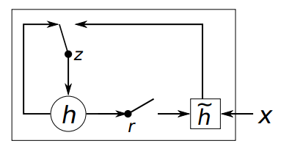
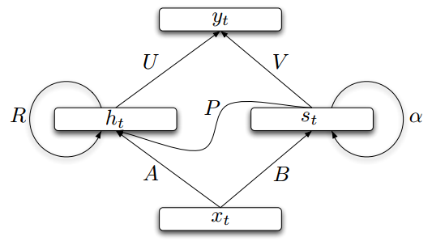
一些简化替代模型
Gated Recurrent Unit (GRU)
Structurally Constrained Recurrent Network (SCRN)
结构受限循环神经网络
[Cho, EMNLP’14]
[Tomas Mikolov, ICLR’15]
GRU 一般比较快
Notes:
Gated Recurrent Unit (GRU):
Structurally Constrained Recurrent Network (SCRN).
Cloclwise RNN

Slide 94
Bidirectional RNN
Notes:
Gated Recurrent Unit (GRU):
Structurally Constrained Recurrent Network (SCRN).
Cloclwise RNN

Slide 95
双向 RNN
Notes:
Gated Recurrent Unit (GRU):
Structurally Constrained Recurrent Network (SCRN).
Cloclwise RNN

Slide 96
Coverage
Introduction to NLP
NLP components and basic methods
Structure of RNN
Long Short-term Memory (LSTM)
Basic language models
BERT
NLP applications

Slide 97
Language Model
P(words) is the joint probability that a sequence of words = w₁ w₂ ... w_{n} is likely for a specified natural language
This joint probability can be expressed using the chain rule (order reversed):
P(w₁ w₂ … w_{n}) = P(w₁) P(w₂ | w₁) P(w₃ | w₁ w₂) ... P(w_{n} | w₁ ... w_{n-1})
Collecting the probabilities is too complex; it requires statistics for m^{n-1} starting sequences for a sequence of n words in a language of m words
Simplification is necessary
Notes:
CLICK EACH SUB

Slide 98
语言模型
Notes:
CLICK EACH SUB

Slide 99
Neural Probabilistic Language Model
Hinton, 1986; Bengio, 2003
Notes:
Algorithmically, these models are similar, except that CBOW predicts target words (e.g. 'mat') from source context words ('the cat sits on the'), while the skip-gram does the inverse and. This inversion might seem like an arbitrary choice, but statistically it has the effect that CBOW smoothes over a lot of the distributional information (by treating an entire context as one observation). For the most part, this turns out to be a useful thing for smaller datasets. However, skip-gram treats each context-target pair as a new observation, and this tends to do better when we have larger datasets. We will focus on the skip-gram model in the rest of this tutorial.

Slide 100
神经概率语言模型
Hinton, 1986; Bengio, 2003
Notes:
Algorithmically, these models are similar, except that CBOW predicts target words (e.g. 'mat') from source context words ('the cat sits on the'), while the skip-gram does the inverse and. This inversion might seem like an arbitrary choice, but statistically it has the effect that CBOW smoothes over a lot of the distributional information (by treating an entire context as one observation). For the most part, this turns out to be a useful thing for smaller datasets. However, skip-gram treats each context-target pair as a new observation, and this tends to do better when we have larger datasets. We will focus on the skip-gram model in the rest of this tutorial.

Slide 101
隐变量(Latent Variable)
Notes:
Algorithmically, these models are similar, except that CBOW predicts target words (e.g. 'mat') from source context words ('the cat sits on the'), while the skip-gram does the inverse and. This inversion might seem like an arbitrary choice, but statistically it has the effect that CBOW smoothes over a lot of the distributional information (by treating an entire context as one observation). For the most part, this turns out to be a useful thing for smaller datasets. However, skip-gram treats each context-target pair as a new observation, and this tends to do better when we have larger datasets. We will focus on the skip-gram model in the rest of this tutorial.

Slide 102
Vector Representation of Words
Vector space models (VSMs) represent (embed) words in a continuous vector space
Theoretical foundation in Linguistics: Distributional Hypothesis
Words with similar meanings will occur with similar neighbors if enough text material is available (Rubenstein et al. 1967).

Slide 103
单词的向量表示法
向量空间模型(VSMs)在一个连续的向量空间中用向量表示单词 。
语言学的理论基础：分布假说
当文本材料足够多时，上下文相似的词语义也相似(Rubenstein et al. 1967).

Slide 104
如何表示词的关系
Sec. 9.2.2
• 我们使用标准符号编码所有的词, 每个词都表示一个维度。
• 不同的词则没有内在相似性
• motel [0 0 0 0 0 0 0 0 0 0 1 0 0 0 0]^{T}
hotel [0 0 0 0 0 0 0 3 0 0 0 0 0 0 0] = 0
• 如果查询的是hotel而我们的文件中有motel，那么我们称我们的查询向量和文件向量是正交的。

Slide 105
Vector Representation of Words
Approaches that leverage VSMs can be divided into two categories
Approach | Example | Description
Count-based methods | Latent semantic analysis | Compute how often some word co-occurs with its neighbor words in a large text corpus, and then map these count-statistics down to a small, dense vector for each word
Predictive methods | Neural probabilistic language model | Directly predict a word from its neighbors in terms of learned small, dense embedding vectors (considered parameters of the model)

Slide 106
单词的向量表示法
现在一般有两种运用VSM的方式
方式 | 例子 | 描述
计数向量表示 | 潜在语义分析 | 计算大型文本语料库中某个单词与其相邻单词同时出现的频率，然后对每个单词将这些计数统计信息映射到的较小的密集向量上
预测方法 | 神经概率语言模型 | 根据学习到的较小的密集嵌入向量（模型的参数）直接从其邻居词预测单词

Slide 107
潜在语义分析

Slide 108
How can we represent term relations?
Sec. 9.2.2
• With the standard symbolic encoding of terms, each term is a dimension
• Diﬀerent terms have no inherent similarity
• motel [0 0 0 0 0 0 0 0 0 0 1 0 0 0 0]^{T}
hotel [0 0 0 0 0 0 0 3 0 0 0 0 0 0 0] = 0
• If query on hotel and document has motel, then our query and document vectors are orthogonal

Slide 109
Word2vec -- Vector Representation of Words
Word2vec: computationally-efficient, 2-layer predictive NN for learning word embeddings from raw text
Considered deep for its ability to digest expansive data sets quickly
Can be used for unsupervised learning of words
Relationships between different words
Ability to abstract higher meaning between words (e.g., Tucson is a city in the state of Arizona)

Slide 110
Word2vec -- 词的向量表达
它的输入是文本语料库，其输出是一组向量或“单词嵌入”（word embeddings, 该语料库中单词的特征向量）
两个单词嵌入之间的相似程度表示单词的概念相似程度

Slide 111
Word2vec -- 词的向量表达
Word2vec: 具有很好的计算性能, 2层预测神经网络用来从原始文本中学习单词嵌入(word embedding)
具有快速消化大量数据集的能力
可用于单词的无监督学习
不同单词之间的关系
能够抽象出单词之间的更高含义（例如，图森是亚利桑那州的一个城市）

Slide 112
Word2vec -- Vector Representation of Words

Slide 113
Word2vec -- 词的向量表达

Slide 114
Word2vec -- 词的向量表达

Slide 115
Word2vec -- Vector Representation of Words
Its input is a text corpus and its output is a set of vectors or “embeddings” (feature vectors for words in that corpus)
Similarity between two embeddings represents conceptual similarity of words

Slide 116
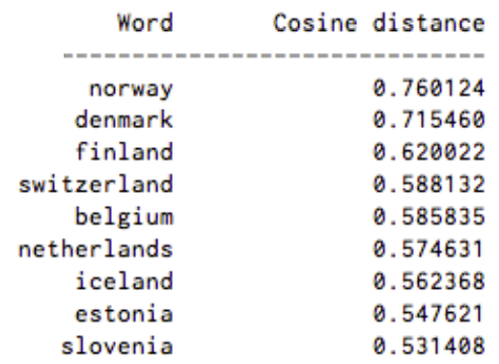
Word2vec -- Vector Representation of Words
Example results: words associated with Sweden, in order of proximity:

Slide 117
Word2vec -- 词的向量表达
示例结果: 与“Sweden”（瑞典）相关的单词，按相似程度排列：

Slide 118
Word2vec -- Vector Representation of Words
Skip-gram learning:
Given w_{0,} predict w₋₂, w₋₁, w₁, and w₂
Conversely, CBOW tries to predict w₀ when given w₋₂, w₋₁, w₁, and w₂
w₋₂ | w₋₁ | w₀ | w₁ | w₂
? | ? | Network | ? | ?
w₋₂ | w₋₁ | w₀ | w₁ | w₂
Recurrent | Neural |  | Language | Model
Notes:
Algorithmically, these models are similar, except that CBOW predicts target words (e.g. 'mat') from source context words ('the cat sits on the'), while the skip-gram does the inverse and. This inversion might seem like an arbitrary choice, but statistically it has the effect that CBOW smoothes over a lot of the distributional information (by treating an entire context as one observation). For the most part, this turns out to be a useful thing for smaller datasets. However, skip-gram treats each context-target pair as a new observation, and this tends to do better when we have larger datasets. We will focus on the skip-gram model in the rest of this tutorial.

Slide 119
Word2vec -- 词的向量表达
Skip-gram 模型:
给定单词 w_{0,} 预测上下文单词 w₋₂, w₋₁, w₁, w₂
与之相反, CBOW (Continuous Bag of Words)尝试通过给定w₋₂, w₋₁, w₁, 和 w₂来计算 w₀
w₋₂ | w₋₁ | w₀ | w₁ | w₂
? | ? | Network | ? | ?
w₋₂ | w₋₁ | w₀ | w₁ | w₂
Recurrent | Neural |  | Language | Model
Notes:
Algorithmically, these models are similar, except that CBOW predicts target words (e.g. 'mat') from source context words ('the cat sits on the'), while the skip-gram does the inverse and. This inversion might seem like an arbitrary choice, but statistically it has the effect that CBOW smoothes over a lot of the distributional information (by treating an entire context as one observation). For the most part, this turns out to be a useful thing for smaller datasets. However, skip-gram treats each context-target pair as a new observation, and this tends to do better when we have larger datasets. We will focus on the skip-gram model in the rest of this tutorial.

Slide 120
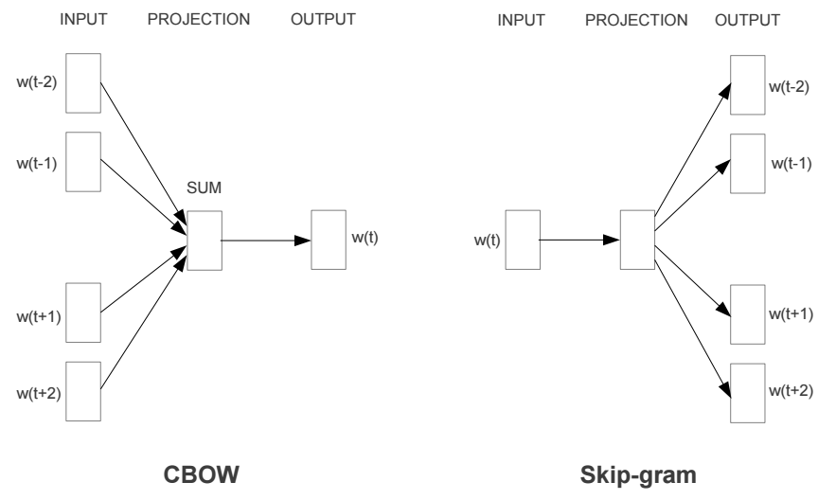
Word2vec Models
Word2vec comes with two models:
Notes:
Algorithmically, these models are similar, except that CBOW predicts target words (e.g. 'mat') from source context words ('the cat sits on the'), while the skip-gram does the inverse and. This inversion might seem like an arbitrary choice, but statistically it has the effect that CBOW smoothes over a lot of the distributional information (by treating an entire context as one observation). For the most part, this turns out to be a useful thing for smaller datasets. However, skip-gram treats each context-target pair as a new observation, and this tends to do better when we have larger datasets. We will focus on the skip-gram model in the rest of this tutorial.

Slide 121
Word2vec 模型
Word2vec 有两个常见模型：
Notes:
Algorithmically, these models are similar, except that CBOW predicts target words (e.g. 'mat') from source context words ('the cat sits on the'), while the skip-gram does the inverse and. This inversion might seem like an arbitrary choice, but statistically it has the effect that CBOW smoothes over a lot of the distributional information (by treating an entire context as one observation). For the most part, this turns out to be a useful thing for smaller datasets. However, skip-gram treats each context-target pair as a new observation, and this tends to do better when we have larger datasets. We will focus on the skip-gram model in the rest of this tutorial.

Slide 122
Word2vec 模型
模型 | 方法 | 速度和表现 | 使用效果
连续词袋模型(CBOW) | CBOW 基于上下文推测当前单词 | 比skip-gram model 训练速度要快 | 预测常见词效果较好
Skip-Gram 模型 | Skip-gram 基于当前单词推测上下文. | 一般比CBOW预测效果要好 | 预测罕见词效果较好
Notes:
Algorithmically, these models are similar, except that CBOW predicts target words (e.g. 'mat') from source context words ('the cat sits on the'), while the skip-gram does the inverse and. This inversion might seem like an arbitrary choice, but statistically it has the effect that CBOW smoothes over a lot of the distributional information (by treating an entire context as one observation). For the most part, this turns out to be a useful thing for smaller datasets. However, skip-gram treats each context-target pair as a new observation, and this tends to do better when we have larger datasets. We will focus on the skip-gram model in the rest of this tutorial.

Slide 123
Word2vec Example

Slide 124
Word2vec 模型

Slide 125
Running Word2Vec
Download: https://code.google.com/archive/p/word2vec/
Word2Vec comes bundled with many files. Two important ones:
Word2vec.c - the actual Word2Vec program written in C; is executed in command line
Demo-word.sh - shell script containing example of how to run Word2Vec.c on test data

Slide 126
运行 Word2Vec
下载: https://code.google.com/archive/p/word2vec/
Word2Vec包里有很多文件。其中关键的两个:
Word2vec.c - c语言编写的Word2Vec程序; 使用命令行执行
Demo-word.sh –包含搭配测试数据运行word2Vec.c程序的shell脚本

Slide 127
Running Word2Vec
To use Word2Vec, you need:
A corpus (e.g., collection of tweets, news articles, product reviews)
Word2Vec expects a sequence of sentences as input
One input file containing many sentences, with one sentence per line
A C programming language compiler
Unix environments are easiest - Linux generally ships with ‘gcc’ pre-installed, OSX can use Xcode

Slide 128
运行 Word2Vec
运行Word2Vec,你需要:
一个语料库(e.g. 微博, 新闻, 商品评价)
Word2Vec 将连续的语句作为输入
一个输入文件包含很多语句, 一条语句一行
一个c语言编译器
Unix系系统的编程环境比较方便 - Linux 一般都有预先装好的gcc, OSX 可以使用Xcode
演示： http://bionlp-www.utu.fi/wv_demo/

Slide 130
Doc2vec构架

Slide 131
Distributed Memory Model of Paragraph Vectors (PV-DM)

Slide 132
Distributed Memory Model of Paragraph Vectors (PV-DM)

Slide 133
Distributed Bag of Words (PV-DBOW)

Slide 134
Doc2vec展示

Slide 135
情感分类
带着愉悦的心情 看了这部电影
这部电影太糟了
这部电影很棒
Positive (正面)
Negative (负面)
Positive (正面)
…
我
觉
得
…
太
好
了

Slide 136
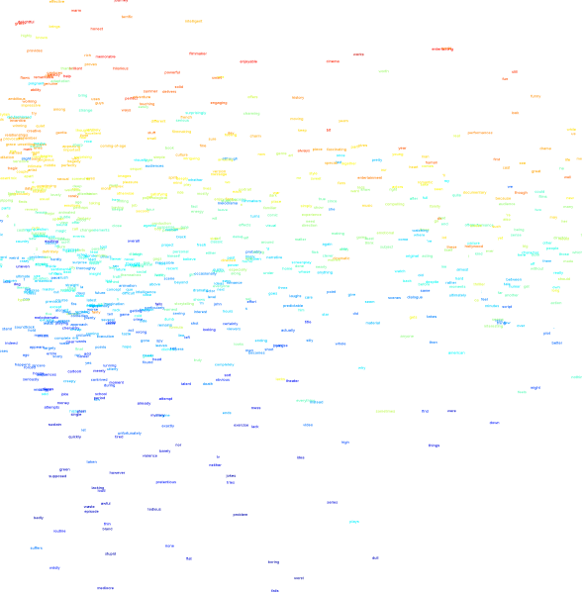
情感分类
Fun
Enjoyable
Worth
Right
Blarblar
Blarblar
dull
boring

Slide 137


情感分析的局限
Sentiment Analysis:
GKG, IMDb reviews
Blue: Obama
Red: Trump
Yellow: Hillary
Notes:
Polynomial

Slide 138
Coverage
Introduction to NLP
NLP components and basic methods
Structure of RNN
Long Short-term Memory (LSTM)
Basic language models
BERT
NLP applications

Slide 139
Transformer: Attention is all your need
https://arxiv.org/abs/1706.03762

Slide 140
Transformer: Attention is all your need
https://arxiv.org/abs/1706.03762

Slide 141
BERT: Bidirectional Encoder Representations from Transformers
https://arxiv.org/abs/1810.04805

Slide 142
BERT Embedding

Slide 143
BERT 结构

Slide 144
GELU: Gaussian Error Linear Unit 高斯误差线性单元
GELU(x)=xP(X≤x)，X follows N(μ,σ2)

Slide 145
BERT 训练

Slide 146
BERT 任务

Slide 147
Transformer Attention

Slide 148
Coverage
Introduction to NLP
NLP components and basic methods
Structure of RNN
Long Short-term Memory (LSTM)
Basic language models
BERT
NLP applications

Slide 149
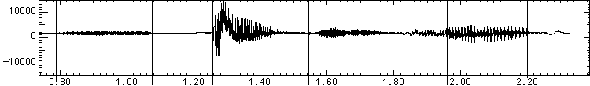
语音系统
自动语音识别(ASR, Automatic Speech Recognition)
输入语音，输出文字
文字转语音(TTS, Text to Speech)
输入文字，输出语音
“Speech Lab”

Slide 150
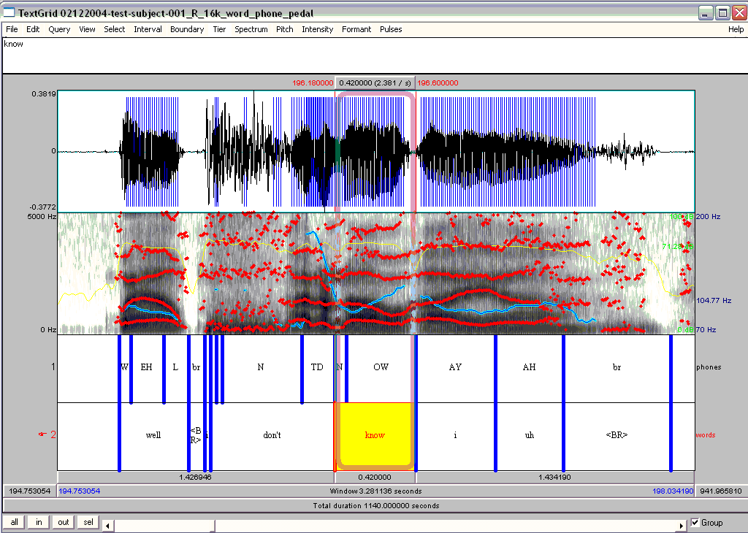
Examples from Prof. Julia Hirschberg’s slides

Slide 151
语音识别
语音识别主要功能是理解语音指令或语音输入中的句子
例子：通信运营商的智能语音客服
语音识别系统首先要能从语音输入中提取出文本信息并识别其中的词
我们可能会希望这个系统同样能够用语音来回答请求- 这意味着同时需要语音生成技术
在自然语言处理领域，输入数据格式要做到机器可读。 (如文本处理成 Unicode 编码格式)
语音识别的未来改进水平将在一定程度上取决于NLP的进展

Slide 152
Speech Recognition
Human languages are limited to a set of about 40 to 50 distinct sounds called phones: e.g.,
[ey] bet
[ah] but
[oy] boy
[em] bottom
[en] button
These phones are characterized in terms of acoustic features, e.g., frequency and amplitude, that can be extracted from the sound waves
Notes:
CLICK EACH

Slide 153
语音识别
人类语言一般只有40到50个不同的具体声位，我们称之为音素
举例：
[ey] bet
[ah] but
[oy] boy
[em] bottom
[en] button
这些音素具有声学特征, 具体的说，我们可以从声波中提取频率和幅度来识别这些音素
Notes:
CLICK EACH

Slide 154
Signal Processing
Wave encoding:
group into ~10 msec frames (larger blocks) that are analyzed individually
frames overlap to ensure important acoustical events at frame boundaries aren't lost
frames are analyzed in terms of features, e.g.,
amount of energy at various frequencies
total energy in a frame
differences from prior frame
vector quantization further encodes by mapping frame into regions in n-dimensional feature space
Notes:
CLICK EACH SUB

Slide 155
信号处理
声波编码:
将一段声波分为约10毫秒的帧（较大的波块）进行分析
重叠相邻帧以确保在边界处的重要声音事件不会丢失
根据特征分析帧, 如,
根据各种频率下的能量分析
根据帧中的总能量分析
根据与前一帧的区别分析
向量量化通过将帧映射到n维特征空间中的区域来进一步编码
Notes:
CLICK EACH SUB

Slide 156
Speech Recognition Model
Bayes‘s Rule is used break up the problem into manageable parts:
P(words|signal) = P(words)P(signal | words)
P(signal)
P(signal): is ignored (normalizing constant)
P(words): Language model
likelihood of words being heard
e.g. "recognize speech" more likely than "wreck a nice beach"
P(signal|words): Acoustic model
likelihood of a signal given words
accounts for differences in pronunciation of words
e.g. given "nice", likelihood that it is pronounced [nuys] etc.
Notes:
CLICK EACH SUB

Slide 157
语音识别模型
贝叶斯法则将问题分解为可求解的子问题：
P(words|signal) = P(words) P(signal | words)
P(signal)
P(signal): 被忽略（归一化常数）
P(words): 语言模型
听到单词的可能性
例如 “recognize speech” 比 “wreck a nice beach”更可能被听到
P(signal|words): 声音模型
给定单词的信号的可能性
也要算上对一个单词的不同发音
例如，对于 “nice”, 可能会被念成 [nuys] 等等
Notes:
CLICK EACH SUB

Slide 158
Applying Language Model
First-order Markov Assumption says the probability of a word depends only on the previous word:
P(w_{i} | w₁ ... w_{i-1}) ≈ P(w_{i} | w_{i-1})
The LM simplifies to
P(w₁ w₂ … w_{n}) = P(w₁) P(w₂ | w₁) P(w₃ | w₂) ... P(w_{n} | w_{n-1})
called the bigram model
it relates consecutive pairs of words
Notes:
CLICK EACH SUB

Slide 159
应用语言模型
一阶马尔可夫假设 认为一个单词出现的概率仅取决于前一个单词：
P(w_{i} | w₁ ... w_{i-1}) » P(w_{i} | w_{i-1})
这个语言模型可简化成
P(w₁ w₂ … w_{n}) = P(w₁) P(w₂ | w₁) P(w₃ | w₂) ... P(w_{n} | w_{n-1})
被称作二元模型
涉及连续的单词对
Notes:
CLICK EACH SUB

Slide 160
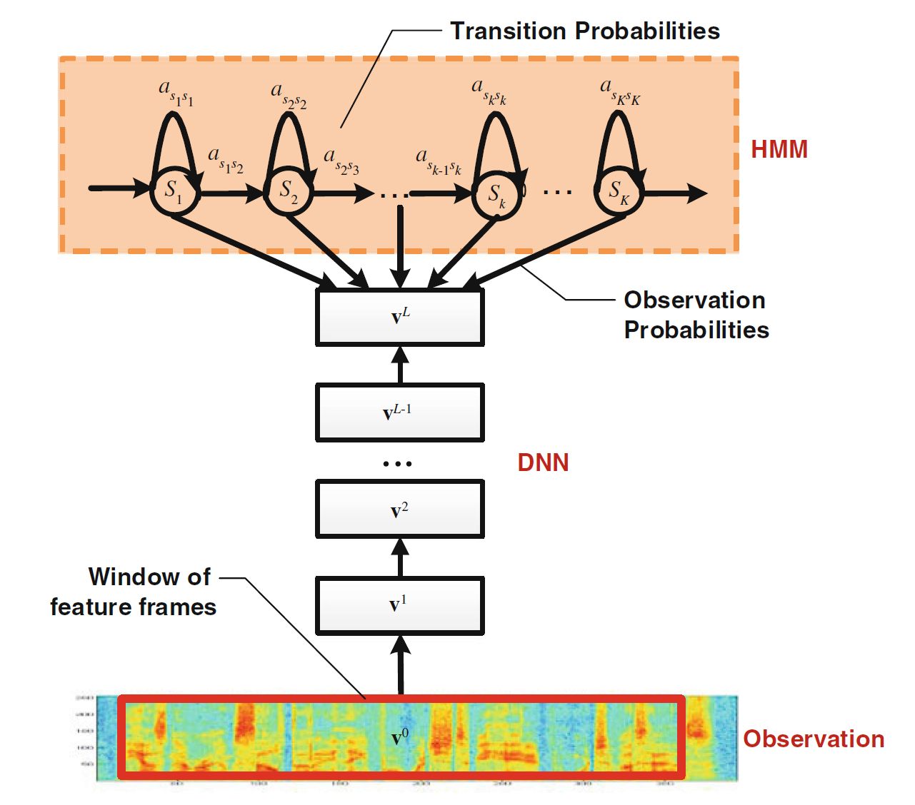
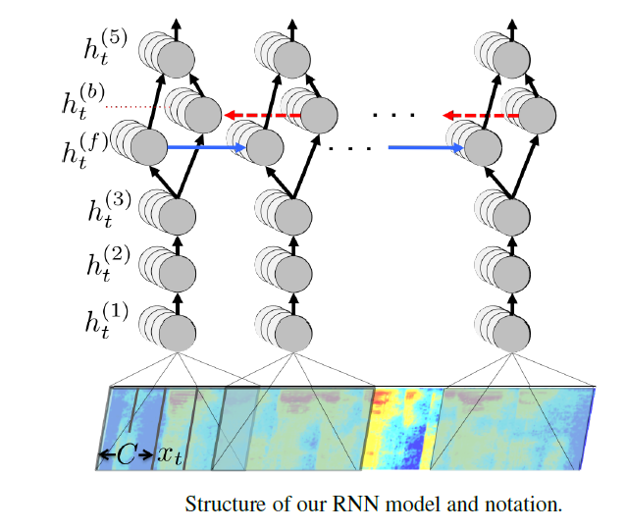
Baidu’s speech recognition using RNN
Recurrent Neural Networks (RNN-HMM)
Baidu Research Approach
Output: Text (Letters, Words, ….)
U³
v³
W³
v²
W²
U¹
v¹
W¹
A. Hannun et al. (Lead by Andrew Ng), “Deep Speech: Scaling up end-to-end speech recognition,” arXiv:1412.5567v2, December 2014.

Slide 161
百度基于RNN构建的语音识别系统
Recurrent Neural Networks (RNN-HMM)
Baidu Research Approach
Output: Text (Letters, Words, ….)
U³
v³
W³
v²
W²
U¹
v¹
W¹
A. Hannun et al. (Lead by Andrew Ng), “Deep Speech: Scaling up end-to-end speech recognition,” arXiv:1412.5567v2, December 2014.

Slide 162
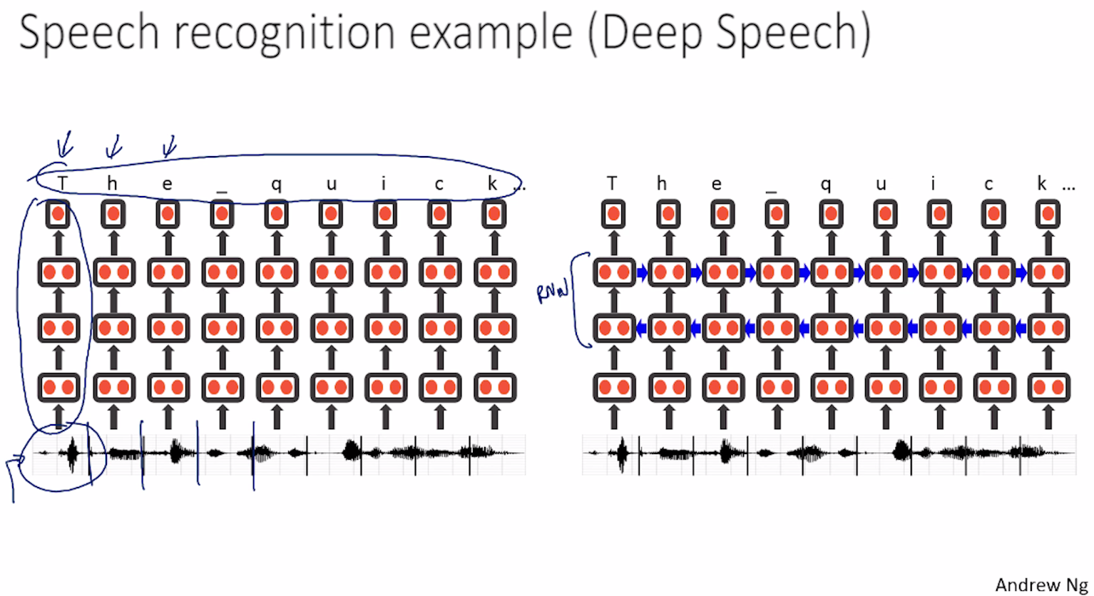
Baidu’s speech recognition using RNN

Slide 163
百度基于RNN构建的语音识别系统

Slide 164
Machine Translation
Machine Translation -- converting a text in language A into the corresponding text in language B (or speech).
Different Machine Translation architectures:
interlingua based systems
transfer based systems
How to acquire the required knowledge resources such as mapping rules and bi-lingual dictionary? By hand or acquire them automatically from corpora.
Example Based Machine Translation acquires the required knowledge (some of it or all of it) from corpora.

Slide 165
机器翻译
每年在人工翻译上花费约100亿美元
机器翻译-将语言A中的文本转换为语言B中的相应文本（或语音）
几个不同的机器翻译架构:
基于国际语言的系统
基于迁移的系统
如何获得所需的知识资源，比如映射规则和双语词典？ 手动或从语料库中自动获取它们。
基于示例的机器翻译从语料库中获取所需的知识（部分或全部） 。
我正在上课
I am teaching

Slide 166
机器翻译

Slide 167
机器翻译
北京一家酒店的售后评价
昨天我打电话订的时候艺龙信誓旦旦的保证说是四星级的酒店,住进去以后一看没,我靠,这在80年代可能算得上是四星的,我要的是368的大床房,房间只有一个0.5米*1米的小窗户,打开一看,我靠, ...‎
"本人刚从酒店回来，很想发表一下自己的看法。总体印象：位置很好，价格也不错，但是服务一般或是太一般了，前台接待的水平和效率 ..."
https://fanyi.baidu.com/
https://translate.google.com/

Slide 168
Natural Language Generation
NLG is the process of constructing natural language outputs from non-linguistic inputs.
NLG can be viewed as the reverse process of NL understanding.
A NLG system may have two main parts:
Discourse Planner -- what will be generated. which sentences.
Surface Realizer -- realizes a sentence from its internal representation.
Lexical Selection -- selecting the correct words describing the concepts.

Slide 169
自然语言生成(NLG)
NLG 是从非语言输入构建自然语言输出的过程。
NLG 可以看作是NLP的逆过程。
一个NLG系统通常有两个主要的部分:
语篇规划器-将会生成什么。生成哪句话。
Surface Realizer -- 从其内部表示实现一个句子。
词汇选择-- 选择描述概念的正确词语。

Slide 170
RNN/LSTM Generation
Music
https://www.youtube.com/watch?v=A2gyidoFsoI
https://www.youtube.com/watch?v=j60J1cGINX4
https://www.youtube.com/watch?v=LSHZ_b05W7o
(Daddy's Car)
Text generator
http://www.cs.toronto.edu/~ilya/rnn.html
Image generator
https://www.youtube.com/watch?v=Zt-7MI9eKEo
https://magenta.tensorflow.org/assets/sketch_rnn_demo/index.html

Slide 171
RNN/LSTM 生成
音乐
https://www.youtube.com/watch?v=A2gyidoFsoI
https://www.youtube.com/watch?v=j60J1cGINX4
https://www.youtube.com/watch?v=LSHZ_b05W7o
(Daddy's Car)
文字生成
http://www.cs.toronto.edu/~ilya/rnn.html
图片生成
https://www.youtube.com/watch?v=Zt-7MI9eKEo
https://magenta.tensorflow.org/assets/sketch_rnn_demo/index.html

Slide 172
Question Answering
How old is Julia Roberts?
When did the Berlin Wall fall?
What about something more open-ended?
Why did the US enter WWII?
How does the Electoral College work?
May want to ask questions about non-English, non-text documents… and get responses back in English text.

Slide 173
问答系统
Julia Roberts多少岁了?
柏林墙什么时候倒的?
更开放式的问题：
美国为何进入二战？
选举团如何运作？
或许可以问有关非英语，非文本文档的问题……并获得英语文本的回复。

Slide 174
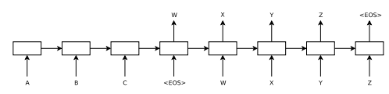
Sequence to Sequence Model
Generate a meaningful response
Language translation
Sentiment analysis

Slide 175
序列到序列模型
产生有意义的回应 语言翻译 情绪分析

Slide 176
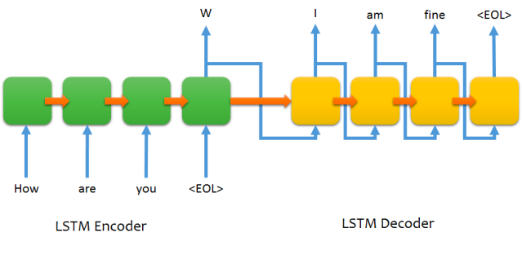
序列到序列聊天模型

Slide 177
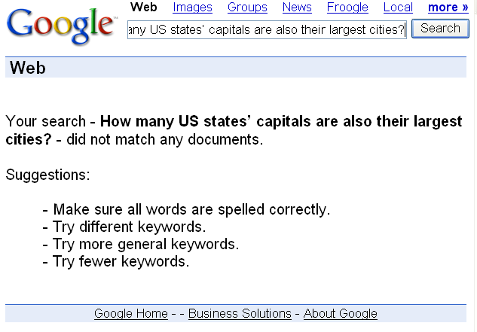

问答系统
问答:
比搜索更复杂
提问收集文档的普适的阅读理解问题
比较容易的问题：
怀俄明州的首府在哪里？
加大难度：
美国有多少州的首府也是最大的城市？
可以是开放式问题:
全球变暖辩论的主要论题是什么
SOTA: 可能文字内容并不特别的匹配，但是可以说出事实

Slide 178
图灵测试
艾伦·图灵（Alan Turing，1950年）提出了人工智能的经验测试。
人类问询者通过打字机向人类和机器询问问题，并试图找出谁是人类，谁是机器。
问：请给我写一个有关福特大桥的十四行诗。
答：这题算我输了。 我实在不会写诗。
问：求34957加70764。
答：（暂停30秒）105621。

Slide 179
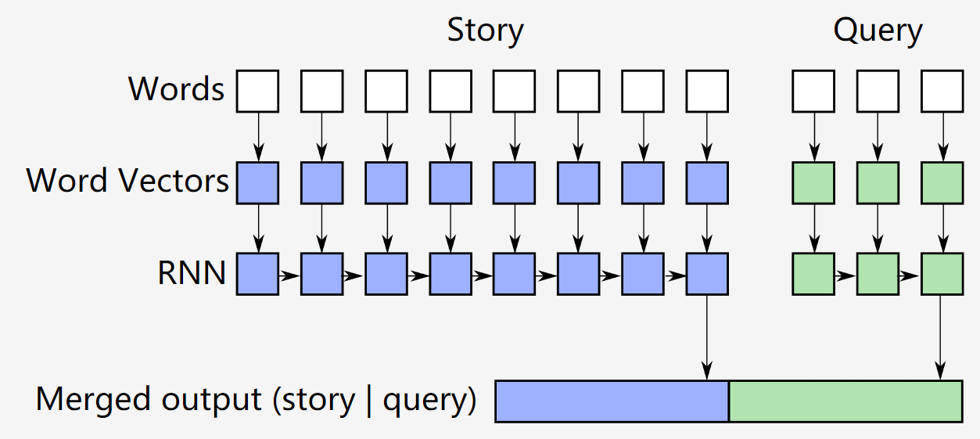
阅读理解
Facebook bAbi tasks
1.约翰去到了卧室。
2.玛丽在那里抢到了足球。
3.桑德拉前往卧室。
4.桑德拉回到走廊。
5.玛丽去到了花园。
6.玛丽去到了办公室。
7.足球在哪里？ 办公室

Slide 180
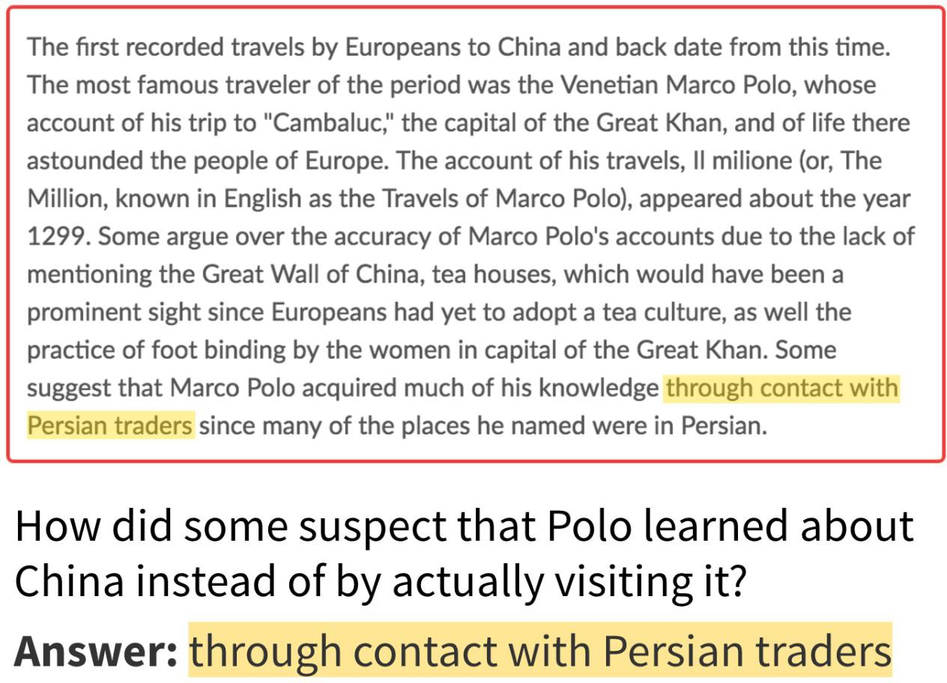
阅读理解

Slide 181
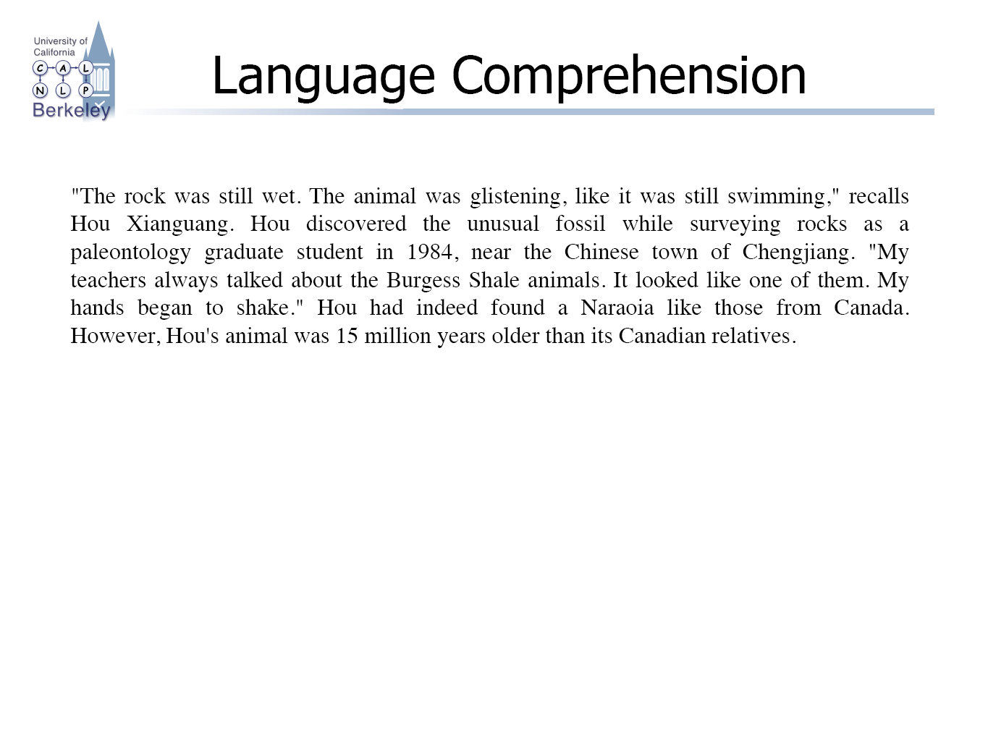
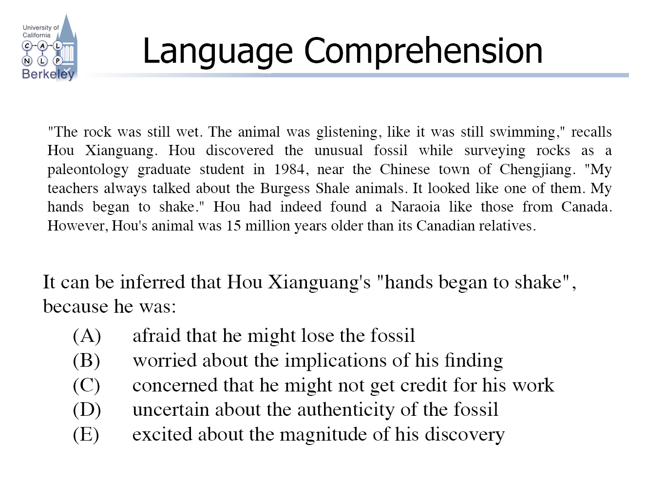
Language Comprehension?

Slide 182
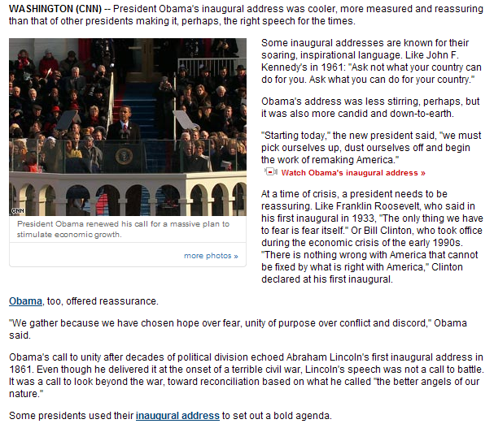
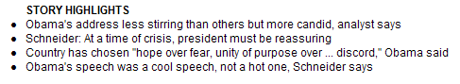
总结文章
压缩文件内容
单个或多个文件
提取或合成
汇总或代表
甚至只是缩短句子
非常依赖上下文!
一个生成分析的例子

Slide 183
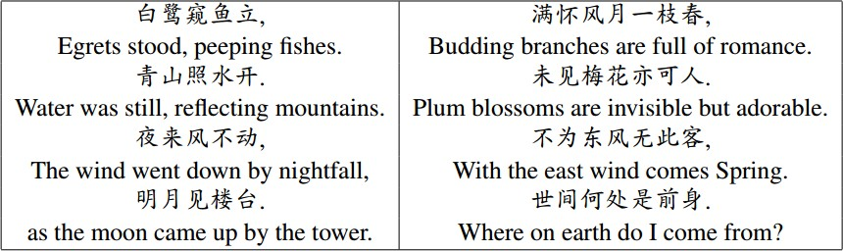
作诗
https://duilian.msra.cn/

Slide 184
Coverage
Introduction to NLP
NLP components and basic methods
Structure of RNN
Long Short-term Memory (LSTM)
Basic language models
BERT
NLP applications

Slide 185
总结
NLP: 语言理解 → 语言生成
词表 → 语料库
句法 → 语义 → 语用 → 语篇
RNN 处理顺序数据并具有存储状态的功能
LSTM 有读、写、保留状态的功能
Word2Vec: 通过神经网络将 words → vectors
BERT: attention 到 transformer
语音识别，问答系统，机器翻译

Slide 186
Further Reading
RNN
https://arxiv.org/pdf/1506.00019.pdf
https://arxiv.org/abs/1406.1078
http://machinelearning.wustl.edu/mlpapers/paper_files/icml2006_GravesFGS06.pdf
LSTM
http://web.eecs.utk.edu/~itamar/courses/ECE-692/Bobby_paper1.pdf
https://arxiv.org/abs/1412.3555
Word2Vec
https://arxiv.org/abs/1301.3781
https://arxiv.org/pdf/1402.3722v1.pdf

Slide 187
Acknowledgments
This file is for the educational purpose only.
Some materials (including pictures and text) were taken from the Internet at the public domain.

